Slide 1
Statistical programming in R
Part 1

Slide 2
Topics covered
Probability
Expectation
Variance
Set theory
Permutations and combinations
Conditional probabilities
Random variables
Discrete and continuous
Central limit theorem

Slide 3
Probability

Slide 4
Chance
Randomness (chance) is everywhere
Probability theory allows us to understand chance logically
P(Event) = how likely that event will occur
Classic example is fair coin toss where P(heads) = P(tails) = 0.5
However, do you expect to see exactly 50% heads and 50% tails with just a few tosses?

Slide 5
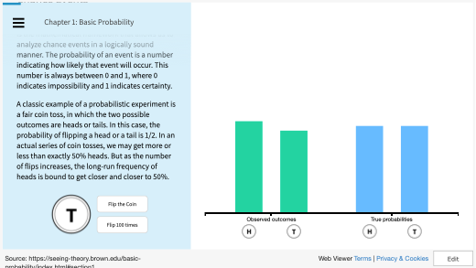
https://seeing-theory.brown.edu/basic-probability/index.html - section1
Notes:
https://seeing-theory.brown.edu/basic-probability/index.html#section

Slide 6
How to simulate a fair coin flip in R
To do this, you will need to learn about the sample(), replicate() and rep() functions
sample() allows you to randomly select n items out of a total of x
For example, sample(c("A","T","G", "C"), 1) will give you 1 randomly-selected base out of 4
replicate() will repeat an action as many times as you like.
For example, replicate(sample(c("A","T","G", "C"), 1), 10) will give you 10 randomly selected bases
rep() will clone an action as many times as you like
For example, rep(sample(c("A","T","G", "C"), 1), 10) will give you 10 x of a randomly selected base as well
Now, try writing your own function coin_toss(n) where n is number of desired coin flips

Slide 7
One possible answer
Notes:
my_fair_dice <- function(n)
{
return(replicate(n, sample(1:6, 1, replace=T)) )
}

Slide 8
How to simulate an unfair coin?
Write a function unfair_coin(n, p), where n is the number of flips, and p is the biased probability e.g 0.7 of getting a head
Hint: sample assumes fair chance so you need to get creative with resolving this issue

Slide 9
One possible answer
It is important you know how to use ? well
?sample will return
sample(x, size, replace = FALSE, prob = NULL)
Where prob is vector of probability weights for obtaining the elements of the vector being sampled.
Is sample(c("H","T"), 1,prob=c(0.7, 0.3)) the expression we are looking for?

Slide 10
One possible answer
Now try to finish writing unfair_coin(n,p)
Verify with the expression
unfair_coin(100, 0.8)
table(unfair_coin(100, 0.8))
What do you see?
Notes:
unfair_coin <- function(n, p)
{
replicate(n, sample(c("H","T"), 1, prob=c(p, 1-p)))
}

Slide 11
Expectation

Slide 12
Expectation
The expectation is a number that captures the center of a random variable’s distribution
In layman’s term, you may know this as the mean
However, it is more accurate to say that this is the probability-weighted sum of all possible values generated from this random variable
E[X]=∑_{x∈X}xP(x)

Slide 13
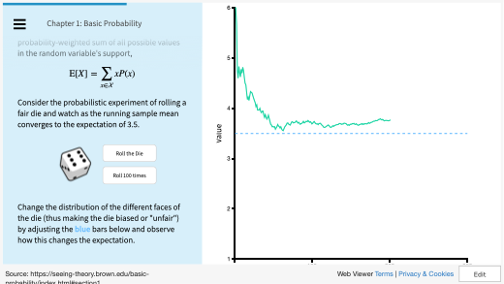
https://seeing-theory.brown.edu/basic-probability/index.html - section1
Notes:
https://seeing-theory.brown.edu/basic-probability/index.html#section1https://seeing-theory.brown.edu/basic-probability/index.html#section

Slide 14
How to write a fair dice in R?
This will be very similar to what we have written previous with the fair coin
But note that a dice has 6 sides
Create a function called my_fair_dice(n) where n is the number of rolls

Slide 15
How to write a dice in R?
Verify your code with the following
expectation <- sum(1:6)/6
observed <- mean(my_fair_dice(100))
observed_deviation <- abs(observed - expectation)
observed_deviation
Try with different values of n (say, 10, 100, 1000). What happens to the observed deviations?
Notes:
my_fair_dice <- function(n)
{
return(replicate(n, sample(1:6, 1, replace=T)) )
}

Slide 16
How to write an unfair dice in R
Create a function called my_bad_dice(n, p) where n is the number of rolls and p is a vector specifying the probabilistic weights of each of the faces from 1 to 6
Verify with my_bad_dice(10, c(0,0,0,0,0.1,0.9))

Slide 17
Variance

Slide 18
Variance
Expectation tells you what is the center of a random variable
However, it does not tell you how spread out the values generated from the random variable is
To understand spread, we need to know how the values vary, using the measure of the variance
The variance is the average value of the squared difference between the random variable and its expectation
Var(X)=E[(X−E[X])²]

Slide 19
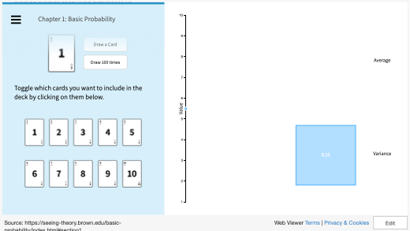
https://seeing-theory.brown.edu/basic-probability/index.html - section1
Notes:
https://seeing-theory.brown.edu/basic-probability/index.html#section1https://seeing-theory.brown.edu/basic-probability/index.html#section

Slide 20
How to do this variance calculation in R?
Write a function my_card_variance(n, c), where n is the number of draws, and c is a vector of card values specified by you.
Evaluate with my_card_variance(100, 1:10)
The expression var(1:10) will give you the true theoretical value of the variance
Using var() is an easier alternative
Notes:
my_card_variance <- function(n,c)
{
sum((replicate(n, sample(c, 1)) - mean(c))^2)/n
}
my_card_variance(100, 1:10)
var(1:10)

Slide 21
Set theory

Slide 22
Set theory
A set is a collection of objects
∪ is union
∩ is intersection
‘ is complement e.g. A’ means complement of A (or not A)
∅ means empty or null

Slide 23
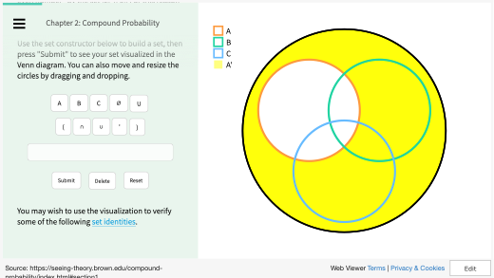
https://seeing-theory.brown.edu/basic-probability/index.html - section1
Notes:
https://seeing-theory.brown.edu/basic-probability/index.html#section1https://seeing-theory.brown.edu/basic-probability/index.html#section

Slide 24
Doing set theory in R
The intersect is performed by intersect()
The union is performed by union()
You will need to be imaginative with complement but you can try setdiff()

Slide 25
Doing set theory in R
Given the following where universe is {1,2,3,4,5,6,7,8,9,10}
A is {1,2,3,4}
B is {3,6,7,8}
Write an expression in R for A’ ∩ B

Slide 26
Doing set theory in R
Hint: Since the universe is specified, you may use setdiff() to generate A’ from A and Universe
U <- c(1:10)
A <- c(1:4)
B <- c(3,6,7:8)
A_complement <- setdiff(U, A)
intersect(A_complement, B)

Slide 27
Permutations and combinations

Slide 28
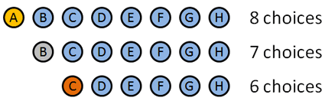
Permutations
How many ways can we pick a Gold, Silver, and Bronze medal for “Best friend in the world”?
Alice
Bob
Charlie
David
Eve
Frank
George
Horatio
Gold medal: 8 choices: A B C D E F G H Let’s say A wins the Gold.
Silver medal: 7 choices: B C D E F G H. Let’s say B wins the silver.
Bronze medal: 6 choices: C D E F G H. Let’s say… C wins the bronze.
Permutations are the total number of doing something in an ordered way.
The total number of options was 8 * 7 * 6 = 336
http://faculty.elgin.edu/

Slide 29



Permutations
You have n items and want to find the number of k ways items can be ordered:
How can ways can we pick 3 items in a specific order out of 8
=
Rules:
1. the n objects are distinct,
2. repeats are not allowed,
3. order matters,

Slide 30


Combinations
The combinations refer to the number of unordered ways to select
Since the order is not important in combinations, we take the number of permutations divided by the number of possible arrangements of k.
Therefore…
Rules:
1. the n objects are distinct,
2. repeats are not allowed,
3. order does not matter

Slide 31
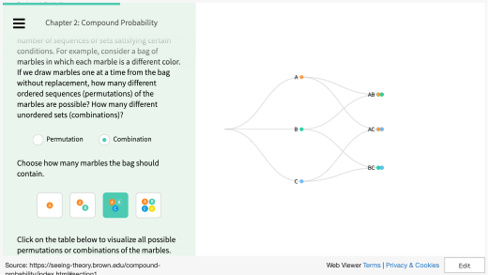
https://seeing-theory.brown.edu/basic-probability/index.html - section1
Notes:
https://seeing-theory.brown.edu/basic-probability/index.html#section1https://seeing-theory.brown.edu/basic-probability/index.html#section

Slide 32
Permutations in R
Factorial in R is performed by factorial() function.
Write a function in R that performs permutation by taking into account n items and number of k ways, returning a numerical value.
Now, write a function my_first_perm(n, k) where n is the number of items, and k is the number of picks
Validate the function with my_first_perm(8, 3)

Slide 33
Permutations in R
Notes:
my_first_perm <- function(n, k)
{
return(factorial(n)/factorial(n-k))
}
my_first_perm(8, 3)

Slide 34
Combinations in R
Factorial in R is performed by factorial() function.
Now, write a function my_first_comb(n, k) where n is the number of items, and k is the number of picks
Validate with my_first_comb(8, 3)

Slide 35
Combinations in R
Notes:
my_first_comb <- function(n, k)
{
return((factorial(n)/factorial(n-k))/factorial(k))
}
my_first_comb(8, 3)

Slide 36
Conditional probabilities

Slide 37
Conditional probabilities
A conditional probability is the probability of an event, given some other event has already occurred
Let P(A) be the probability of a ball hitting the red shelf
Let P(B) be the probability of a ball hitting the blue shelf
The probability of a ball hitting the red shelf, given that it hit the blue shelf is P(A|B) = P(AnB)/P(B)
Check out http://setosa.io/conditional/

Slide 38
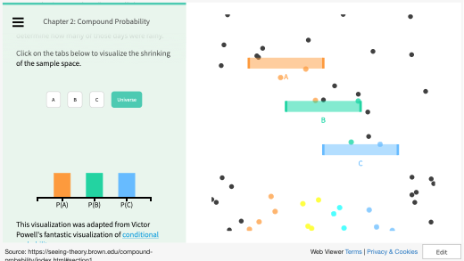
https://seeing-theory.brown.edu/basic-probability/index.html - section1
Notes:
https://seeing-theory.brown.edu/basic-probability/index.html#section1https://seeing-theory.brown.edu/basic-probability/index.html#section

Slide 39
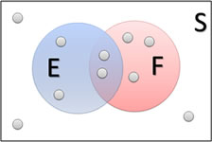
Conditional Probability for non-independent events (Example 1)
Find P(E|F)
Find P(F|E)
Hint: P(E|F) is the probability of getting E given that F has already happened
P(E|F) = 2/5
P(F|E) = 2/4

Slide 40
Conditional Probability for non-independent events (Example 2)
Recall: Conditional Probability
The notation P(F|E) is read "the probability of F given E" and represent the probability that event F occurs, given that event E has already occurred.
Given a stack of cards, we define the following events:
E = the first card drawn is a King
F = the second card drawn is a King
Find P(F|E).
Ans: P(F|E) is the probability that the second card is a king given if the first card drawn was a king. In that case, there will be 3 kings left out of 51 cards, so
P(F|E) = 3/51

Slide 41
Conditional Probability for non-independent events (Example 2, cont.)
Consider the experiment where two cards are drawn without replacement. (Without replacement means one is drawn and then the second is drawn without putting the first one back.) Define events E and F this way:
E = the first card drawn is a King
F = the second card drawn is a King
How would we find P(E and F)?
E and F are not independent, so we know we can't use the Multiplication Rule for Independent Events.
P(E and F) not equals to P(E) * P(F)
P(E and F) equals to P(E) * P(F|E)
P(E and F) = P(first is King and second is King)
= P(first is King)*P(second is King given first is King)
= (4/52)*(3/51)
≈ 0.0045

Slide 42
Let’s see how we can do this in R
cards <- c(rep(0, 48), rep(1, 4))
cards <- sample(cards) #shuffle our cards
matrix <- replicate(100000, sample(cards, 2)) #no replacement
table(colSums(matrix)==2)
*A rule --- if you expect very very small probability, you need to sample enough times to actually detect that small probability (one order of magnitude below)
Consider what happens if we sample with replacement
matrix <- replicate(100000, sample(cards, 2,replace=T))
table(colSums(matrix)==2)

Slide 43
Conditional Probability for non-independent events (Example 3)
Consider a bag of marbles (10 red, 20 blue, and 15 green). Suppose two marbles are drawn without replacement.
What is the probability that both marbles drawn are red?
Let E be the event that the first draw is red, and F be the event the second draw is red
Let P(E) be the probability that the first draw is red = 10/45
Let P(F|E) be the probability that the second draw is red given the first is red = 9/44
P(E and F) = P(E) * P(F|E) = 10/45 * 9/44 = 0.0455
http://faculty.elgin.edu/

Slide 44
Random variables

Slide 45
Random variable
This is a function that assigns some value to each a given outcome probabilistically
For example, gender distribution is a random variable where male and female each have 0.5 chance.
Suppose I choose 10 people, then likelihood of me getting 6:4, 5:5, 7:3 M:F is determined by the chances as determined above

Slide 46
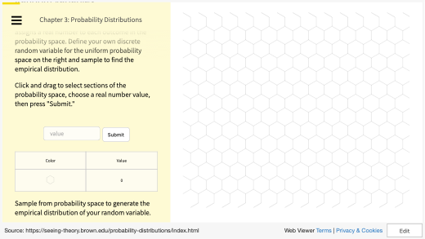
https://seeing-theory.brown.edu/basic-probability/index.html - section1
Notes:
https://seeing-theory.brown.edu/basic-probability/index.html#section1https://seeing-theory.brown.edu/basic-probability/index.html#section

Slide 47
Random variables in R
Write a function called my_gender(n) where n is the number of selected people and returns a number of males and females
Validate your expression with replicate(10, my_gender(100))
What do you notice?
Notes:
my_gender <- function(n)
{
return(table(replicate(n, sample(c("M","F"),1))))
}

Slide 48
Discrete and continuous

Slide 49
There are 2 main kinds of probability distributions
Discrete
Continuous
Counts-based
number of people in class
Non-counts based
weight

Slide 50
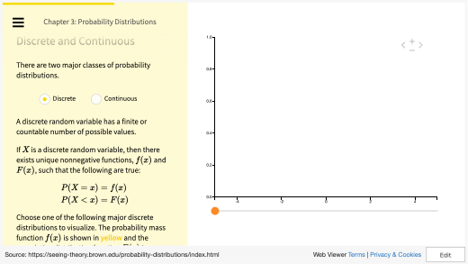
https://seeing-theory.brown.edu/basic-probability/index.html - section1
Notes:
https://seeing-theory.brown.edu/basic-probability/index.html#section1https://seeing-theory.brown.edu/basic-probability/index.html#section

Slide 51
Binomial distribution in R
The binomial distribution is a discrete probability distribution. It describes the outcome of n independent trials in an experiment
Each trial is assumed to have only two outcomes, either success or failure
If the probability of a successful trial is p, then the probability of having x successful outcomes in an experiment of n independent trials is as follows:

Slide 52
Binomial distribution in R
Problem
Suppose there are twelve multiple choice questions in an English class quiz. Each question has five possible answers, and only one of them is correct. Find the probability of having four or less correct answers if a student attempts to answer every question at random.
Solution
Since only one out of five possible answers is correct, the probability of answering a question correctly by random is 1/5=0.2. We can find the probability of having exactly 4 correct answers by random attempts as follows.
dbinom(4, size=12, prob=0.2)

Slide 53
Binomial distribution in R
Solution (cont.)
To find the probability of having four or less correct answers by random attempts, we apply the function dbinom with x = 0,…,4.
dbinom(0, size=12, prob=0.2) + dbinom(1, size=12, prob=0.2) + dbinom(2, size=12, prob=0.2) + dbinom(3, size=12, prob=0.2) + dbinom(4, size=12, prob=0.2)
Solution (quicker)
pbinom(4, size=12, prob=0.2)
Answer
The probability of four or less questions answered correctly by random in a twelve question multiple choice quiz is 92.7%.

Slide 54
Normal distribution in R
The normal distribution is defined by the following probability density function, where μ is the population mean and σ² is the variance.
If a random variable X follows the normal distribution, then we write:

Slide 55
Normal distribution in R
In particular, the normal distribution with μ = 0 and σ = 1 is called the standard normal distribution, and is denoted as N(0,1). It can be graphed as follows.

Slide 56
Normal distribution in R
The normal distribution is important because of the Central Limit Theorem, which states that the population of all possible samples of size n from a population with mean μ and variance σ² approaches a normal distribution with mean μ and σ²∕n when n approaches infinity.
More on the Central Limit theorem in the next section

Slide 57
Normal distribution in R
Problem
Assume that the test scores of a college entrance exam fits a normal distribution. Furthermore, the mean test score is 72, and the standard deviation is 15.2. What is the percentage of students scoring 84 or more in the exam?
Solution
We apply the function pnorm of the normal distribution with mean 72 and standard deviation 15.2. Since we are looking for the percentage of students scoring higher than 84, we are interested in the upper tail of the normal distribution.

Slide 58
Normal distribution in R
Solution (cont.)
pnorm(84, mean=72, sd=15.2, lower.tail=FALSE)
Answer
The percentage of students scoring 84 or more in the college entrance exam is 21.5%.

Slide 59
Central limit theorem

Slide 60
Central limit theorem
The Central Limit Theorem (CLT) states that the sample mean of a sufficiently large number of i.i.d. random variables is approximately normally distributed.
The larger the sample, the better the approximation.

Slide 61
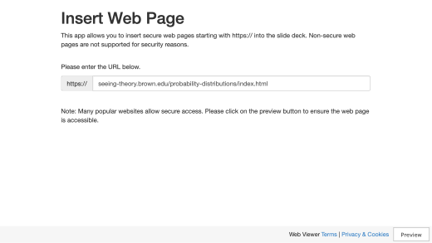
https://seeing-theory.brown.edu/basic-probability/index.html - section1
Notes:
https://seeing-theory.brown.edu/basic-probability/index.html#section1https://seeing-theory.brown.edu/basic-probability/index.html#section

Slide 62
Central limit theorem in R
We simulate an experiment 2,000 times, taking random draws from a Binomial distribution with a 0.05 probability success rate.
We use four sample sizes: 20, 100, 500, and 1,000.
For the mean of each sample size, we also calculate the Z-score, i.e. a measure of how many standard deviations below or above the population mean a raw score is.
Try doing this yourself first
Hint: you may use the normal approximation to the binomial distribution instead

Slide 63
Central limit theorem in R
set.seed(123)
n <- 4 # Number of trials (population size) s <- 2000 # Number of simulations m <- c(20, 100, 500, 1000)
p <- 0.05
EX <- n*p VarX <- n*p*(1-p)
Z_score <- matrix(NA, nrow = s, ncol = length(m)) for (i in 1:s){ for (j in 1:length(m)){ # loop over sample size samp <- rbinom(n = m[j], size = n, prob = 0.05) sample_mean <- mean(samp) # sample mean # Calculate Z score for mean of each sample size Z_score[i,j] <- (sample_mean-EX)/sqrt(VarX/m[j]) } }

Slide 64
Central limit theorem in R
par(mfrow=c(2,2))
for (j in 1:4){
hist(Z_score[,j], xlim=c(-5,5),
freq=FALSE, ylim=c(0, 0.5),
ylab="Probability", xlab="",
main=paste("Sample Size =", m[j]))
# Density curve
x <- seq(-4, 4, by=0.01)
y <- dnorm(x)
lines(x, y, col="blue")
}
dev.off()

Slide 65
Central limit theorem in R

Slide 66
End of Segment
Let’s take a break

